Slide 1
Uncontrolled copy not subject to amendment
Principles of Flight
Learning Outcome 2
Understand how the stability and manoeuvrability of an aeroplane are controlled
Part 4: describe how aircraft and controls can be used for manoeuvrability
Revision 2.00

Slide 2
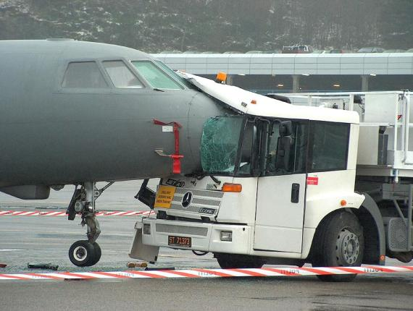
Principles of Flight
Revision

Slide 3
Questions for you …..

Slide 4
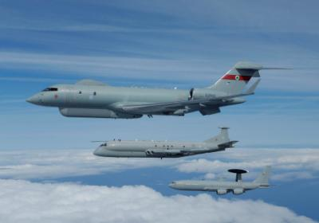
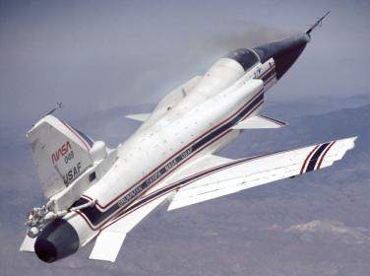
1. What are the 3 planes of an aircraft’s movement?
a. Pitching, lateral and rolling
b. Pitching, rolling and yawing
c. Yawing, longitudinal and rolling
d. Longitudinal, lateral and normal

Slide 5
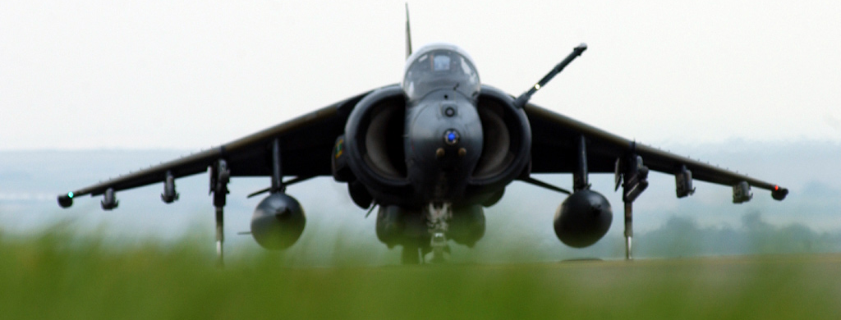
2. Which one of the following will REDUCE lateral stability?
a. Dihedral
b. A large fin
c. Sweepback
d. Anhedral

Slide 6
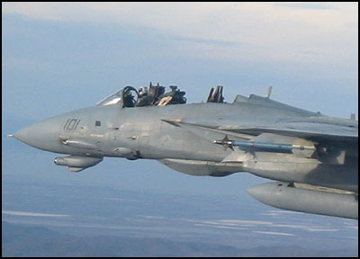
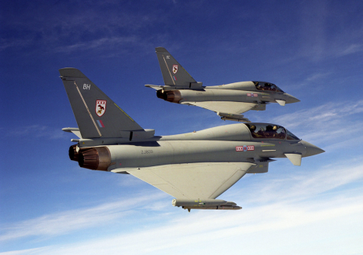
3. What are the 3 axes about which an aircraft can move?
a. Pitching, lateral and longitudinal
b. Pitching, rolling and yawing
c. Yawing, longitudinal and normal
d. Longitudinal, lateral and normal

Slide 7
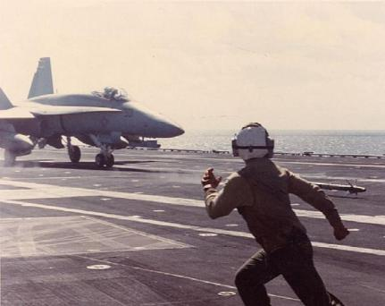
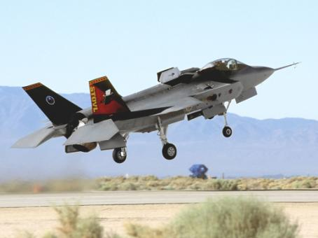
4. Which three terms describe static stability?
a. Stable, neutral and unstable
b. Stable, rolling and unstable
c. Yawing, neutral and stable
d. Neutral, unstable and pitching

Slide 8
Primary flying controls and trimming devices
Objectives:
List the pilot’s primary flying controls
Describe pitching, rolling and yawing movements
Understand how pitching, yawing and rolling are all related to the pilot
Identify and state the purpose of trimming tabs
Describe how trimming devices work
Explain the use of elevators, ailerons and rudder

Slide 9
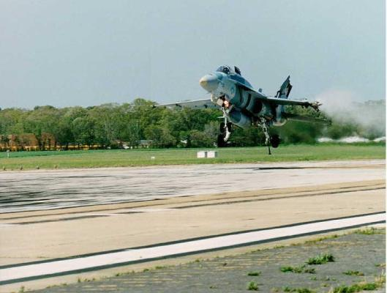
Flying controls
We know how an aircraft flies, but how do we
control it?

Slide 10
There are three primary flying controls:
Elevators
Ailerons
Rudder
Pitch
Roll
Yaw
Nose up/down
Wings one up/one down
Nose left/right
ALL control inputs are relative to the pilot
regardless of the aircraft’s attitude or position

Slide 11
Elevators
Rudder
Ailerons

Slide 12
Elevators
Longitudinal control affecting pitch
Flight
path
Notes:
LONGITUDINAL STABILITY
longitudinal static stability the tailplane contribution must overcome the unstable wing
Therefore, start with the assumption that C.G and Cp are coincident
For simplicity assume stick fixed ie elevators locked

Slide 13
Ailerons
Lateral control affecting roll
Notes:
Big Fin / Diehedral / Anhedral Sweepback Wing Fuselage Interference

Slide 14
Rudder
Directional control affecting yaw
Flight
path
Notes:
DIRECTIONAL STABILITY
CofG, Stabilising, destabilising, moment arm
Keel ahead/behind CofG destabilising and stabilising respectively
Now on slide fin is at AOA therefore lift is generated.
What about the CofP ahead of the CofG???
What about fin?

Slide 15
Trimming
We are flying straight and level, but something
changes .....
We have:
Increased or decreased speed
Used our fuel
Dropped bombs
Fired our guns
(Eaten all of the rations!)
Notes:
The weight and the position of an aircraft’s centre of gravity can change in flight, when fuel is used up, bombs dropped, ammunition fired and so on.
The centre of pressure will also change during the flight - usually with alterations of power, speed or attitude. All such changes will affect the balance of forces on the aircraft, sometimes quite markedly. For example a sideways pressure on the stick would be needed to keep the aircraft balanced if fuel is used from the left wing tank quicker than from the one on the right, making the aircraft right-wing heavy. Or on a multi-engined aircraft, should one engine fail or lose power, the differential thrust on the two wings would produce a yawing force which would have to be opposed by constant pressure on a rudder pedal, to maintain direction. In all these conditions, no pilot could fly accurately and safely for long without some help.

Slide 16
The aircraft is now out of balance and we may be holding a “stick force” to fly
This will be tiring and prevent the pilot from carrying out other tasks such as navigation
What can we do?
Trim the aircraft
Notes:
The help provided on most aircraft comes in the form of trimming tabs which can be used to “trim out” (or cancel out) the forces on the stick or rudder. They are hinged to the trailing edges of the elevators, ailerons and rudder, and can be moved at an angle to those surfaces by separate controls in the cockpit. Suppose that an aircraft has become nose-heavy and the pilot has to maintain a steady backward pressure on the stick; the pilot is all the time holding the elevators up at a slight angle. To trim out the constant backward force on the stick, the pilot operates the elevator trim control in the cockpit so as to depress the elevator trimming tabs downward into the airflow.
As the tabs are now at an angle of attack to the airflow, they produce lift which helps to hold the elevator up at the required angle. Finally the pilot adjusts the elevator trimming tabs until they are exerting enough force to remove entirely the need to hold a pressure on the control column. The airflow on the elevator trimming tabs is producing the necessary upward force on the elevator. The aircraft is said to be trimmed longitudinally and will fly “hands off”. Aileron and rudder trimming tabs operate on the same principle.

Slide 17
Trim tabs
Notes:
Tabs/Explain moment arms ∴ smaller trim tab

Slide 18
Notes:
Tabs/Explain moment arms ∴ smaller trim tab

Slide 19
Pull force
+ + +
+ +
Stick force remains
Notes:
Tabs/Explain moment arms ∴ smaller trim tab

Slide 20
Larger moment arm
+
Pull force
+ + +
+ +
Stick force remains
Stick force removed
Notes:
Tabs/Explain moment arms ∴ smaller trim tab

Slide 21
To control column
Fixed tab
Notes:
Fixed tabs/Examples

Slide 22
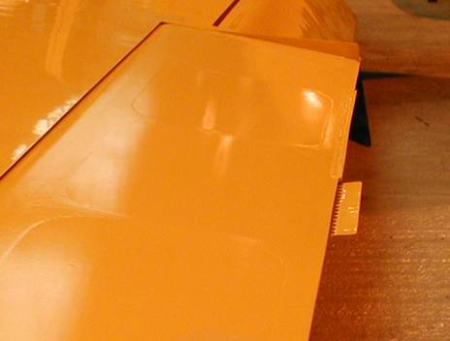
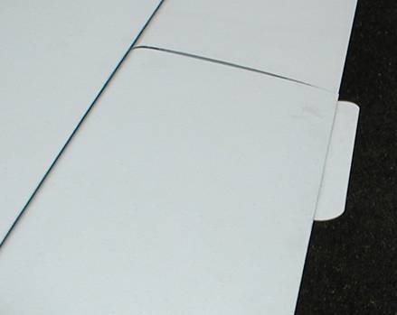
Fixed tabs
To reduce the pilot’s physical workload
Notes:
Fixed tabs/Examples

Slide 23
Trim Tabs
To trim wheel
To control column
Trim tab
Can be adjusted in the air
Notes:
Various ways of achieving tab balance

Slide 24
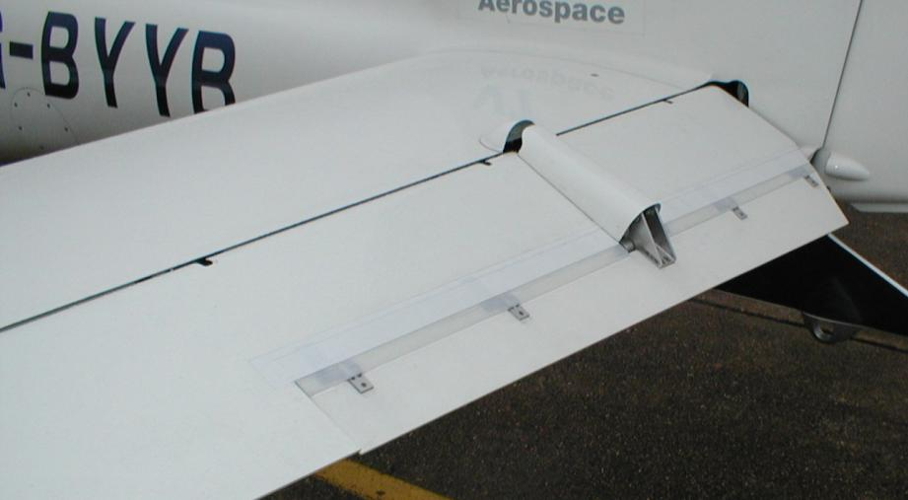
Trim tabs help to reduce the pilot’s physical workload
Notes:
Various ways of achieving tab balance

Slide 25
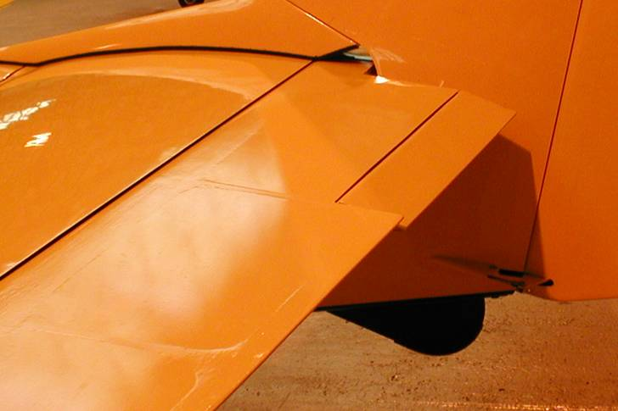
Notes:
Various ways of achieving tab balance

Slide 26
Aerodynamic balancing
Geared tab
Notes:
Geared tab

Slide 27
Trim Tabs
Remember - Trim tabs work in the natural sense
i.e.
If you are pulling back on the control column to
control the aircraft, then you trim back on the trimmer

Slide 28
Any questions?

Slide 29
Questions for you …..

Slide 30
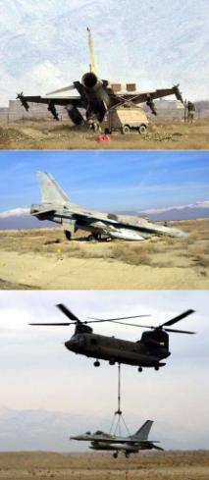
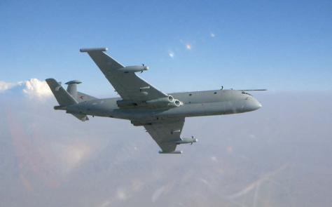
1. Which surfaces control an aircraft in the rolling plane?
          a. Elevators
          b. Ailerons
          c. Rudder
          d. Tabs

Slide 31
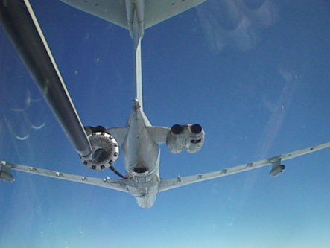
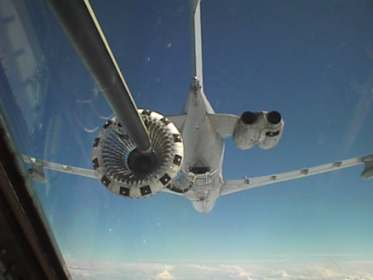
We pitch an aircraft by using the:
a. Elevators
b. Ailerons
c. Rudder
d. Tabs

Slide 32
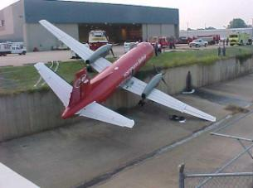
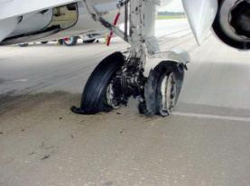
3. What may cause an imbalance in roll?
a. Uneven tyre pressures
b. Rudder not central
c. Wing fuel imbalance
d. A heavy co-pilot!

Slide 33
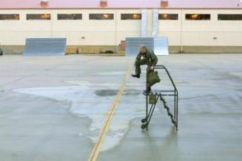
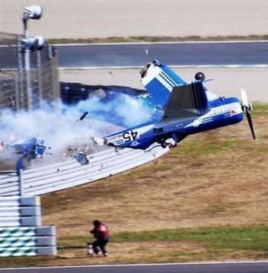
4. On an aircraft with two wing mounted engines, which control would be used to keep the aircraft straight if one engine failed?
a. Elevators
b. Ailerons
c. Rudder
d. Tabs

Slide 34
